Slide 1

Play to Win Campus: India
July 2020

Slide 2

Leadership summit February 2020, Paris
A Reality Check!

Slide 3
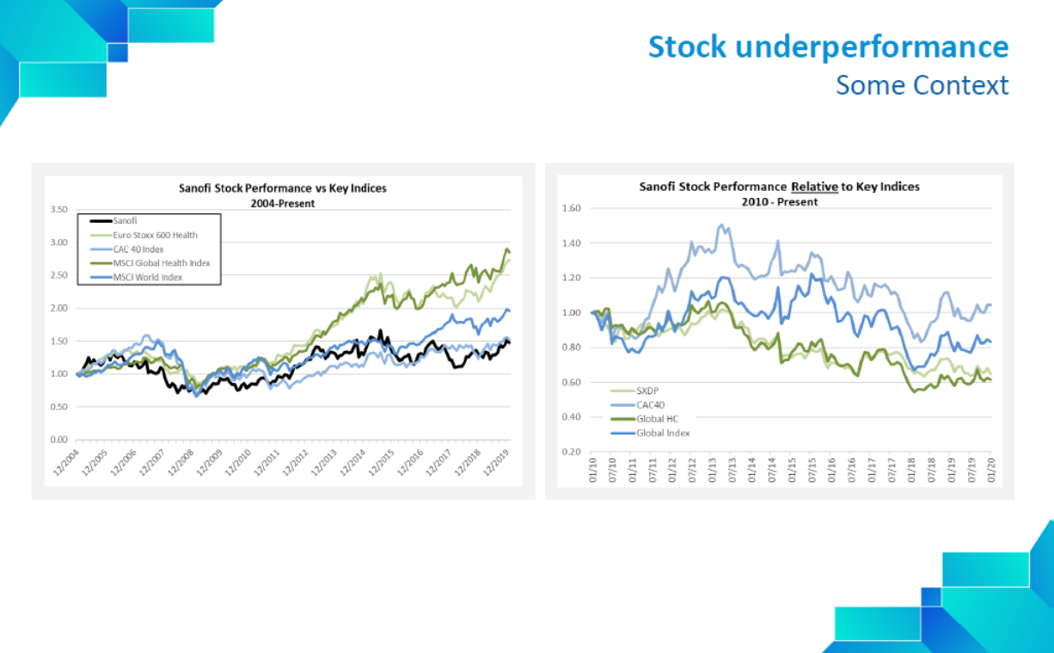
Stock underperformance

Slide 4
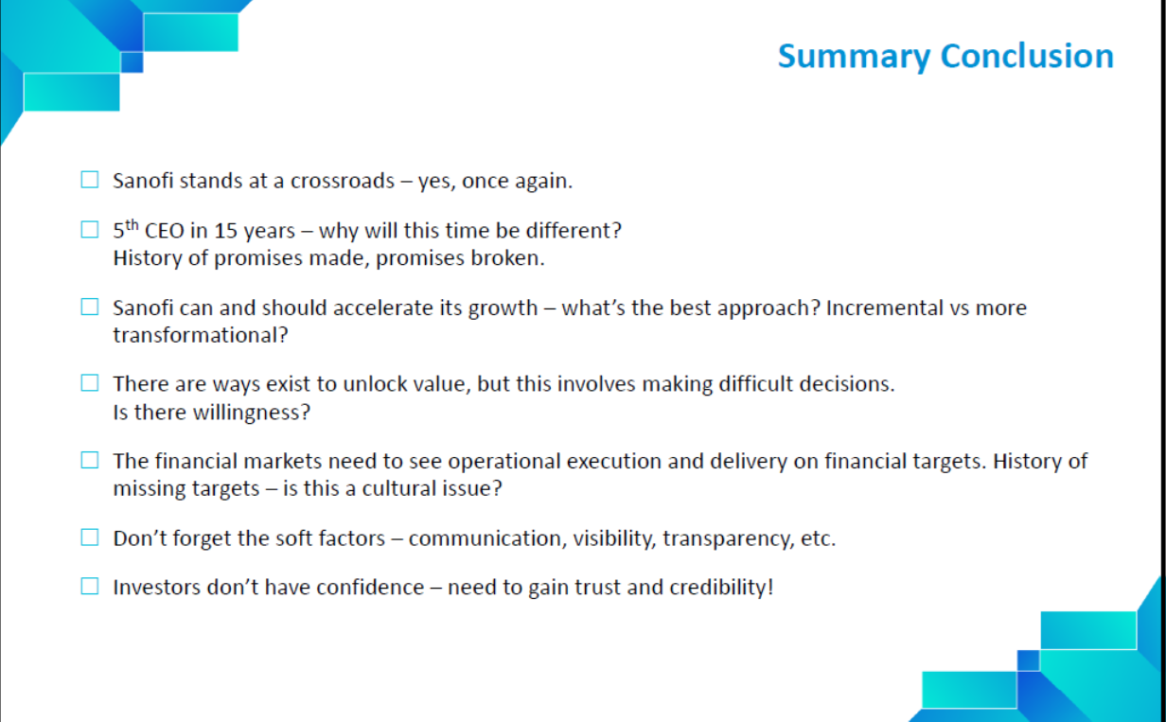
Summary conclusion

Slide 5
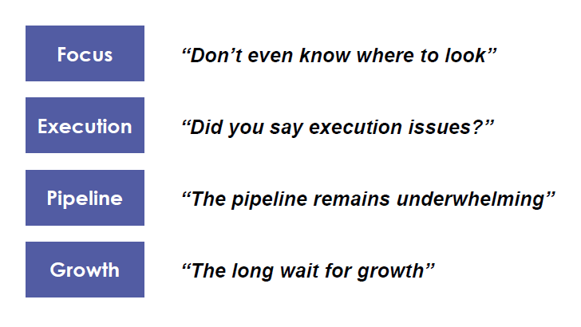
Select analyst quotes – 2014-2019

Slide 6
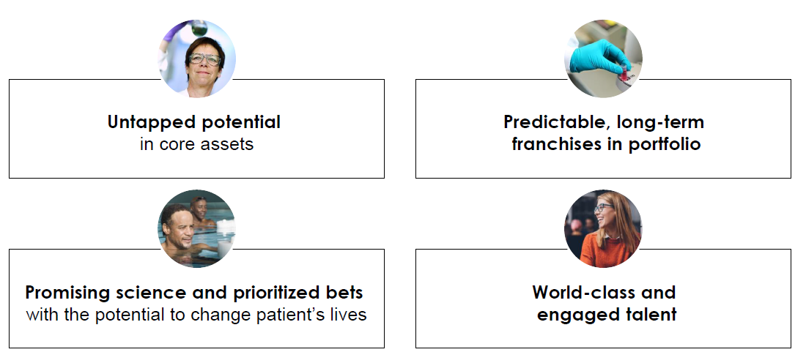
Current untapped opportunities

Slide 7


Slide 8
Introduction
Notes:
You must have seen lot of excitement in past… Paul Hudson …CEO message … copied my motto but any way that’s ok .. Another india export
The three days agenda will answer these 3 questions for Play to Win – strategy and more focus on Culture

Slide 9
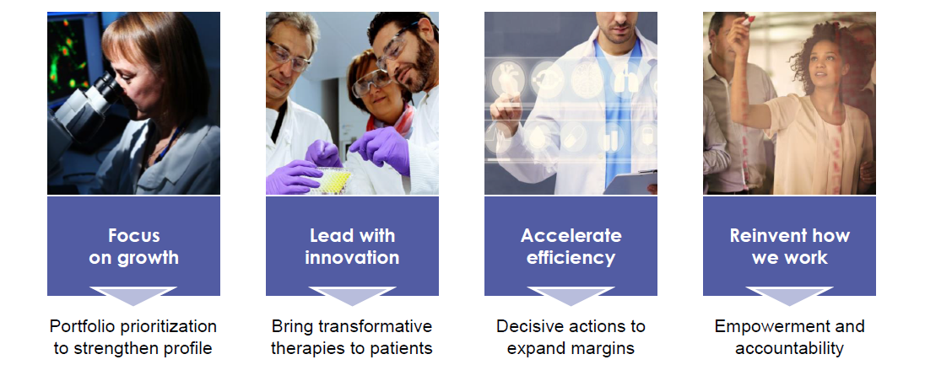
‘Play to Win’ Strategic Pillars
Driving innovation and growth with strategic choices

Slide 10
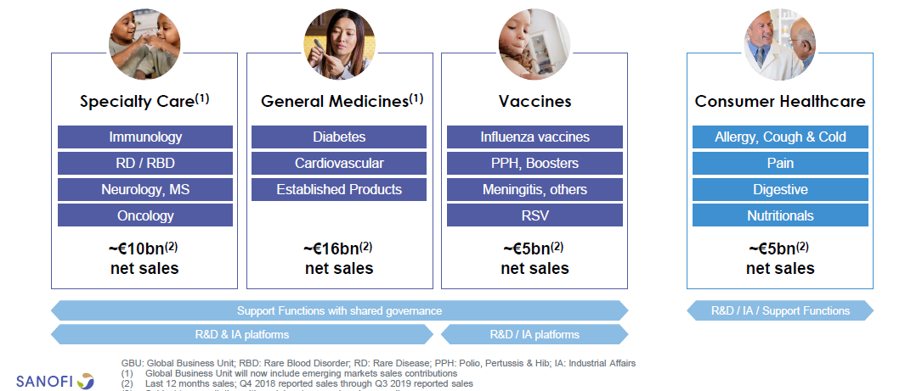
New Global Business Unit Organization

Slide 11
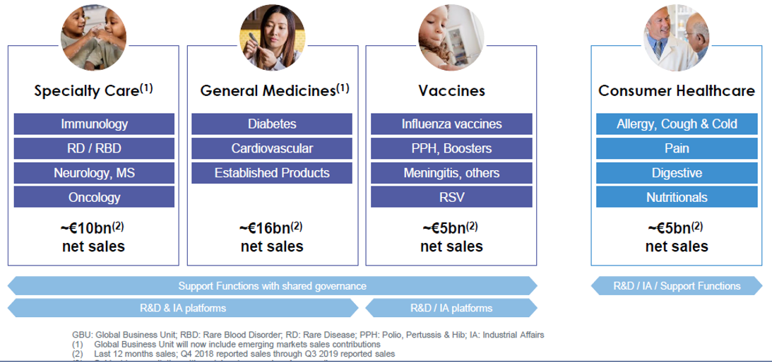




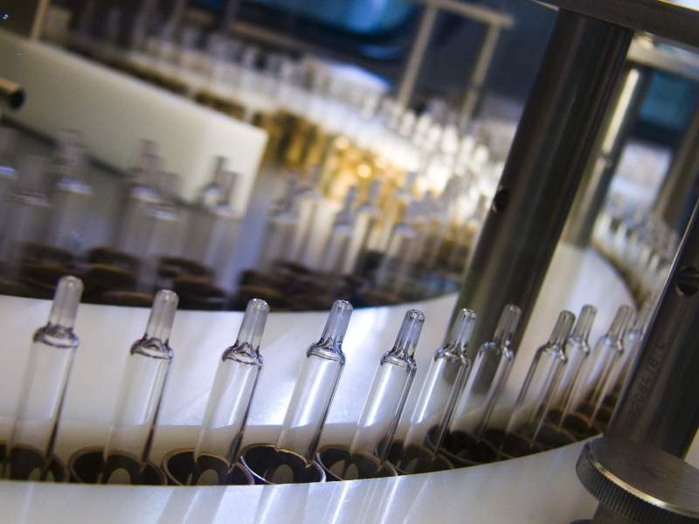
Play to Win
Key changes
Integrated GBUs
GloCal Operations
Country Council
Geographical Alignment
Integrated R&D
End to End Manufacturing

Slide 12

One pivotal change
New Behaviors

Slide 13
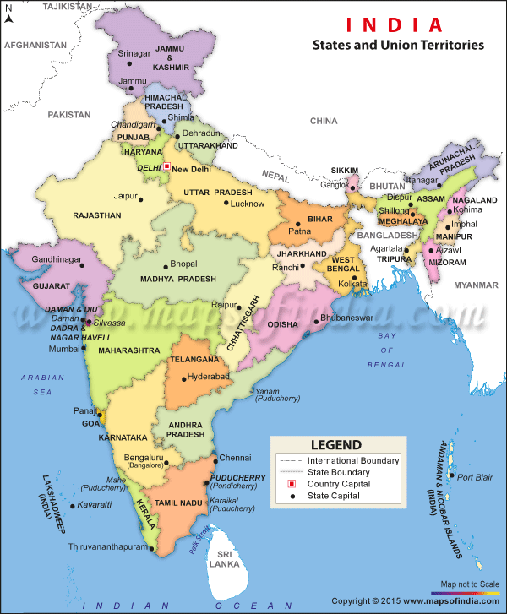
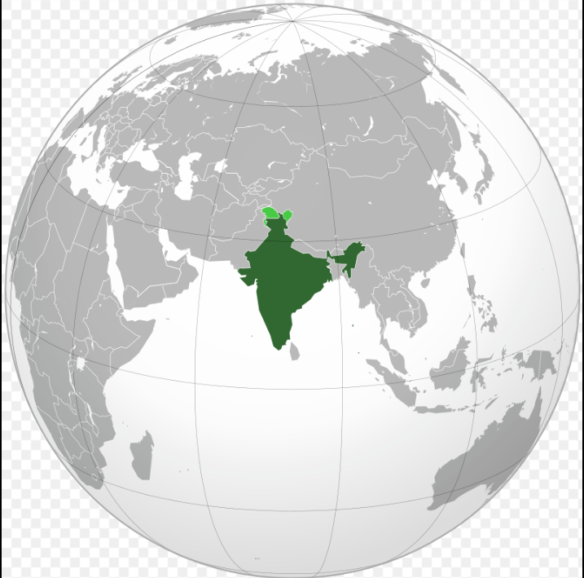
Zooming in on India

Slide 14


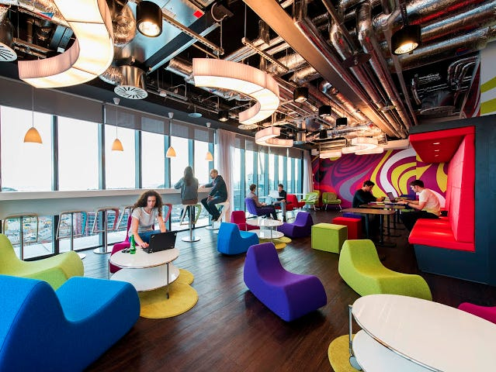
How do we fare in India?
Business Health
People Growth
The Smell of the Place
Strategy
Growth
Market position
Job satisfaction
Growth
Movements
Systems
Symbols
Behavior

Slide 15
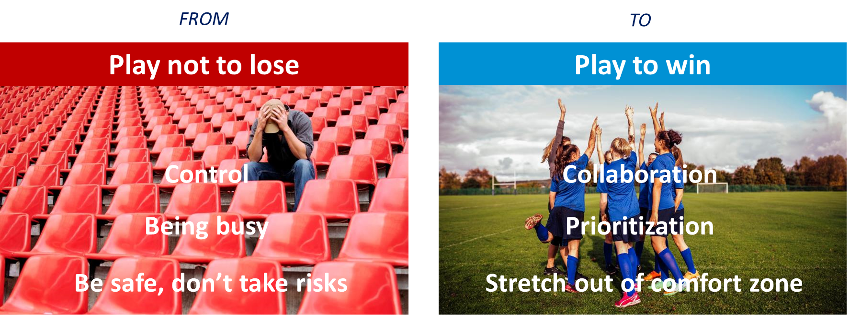
To succeed,
we need to shift our beliefs

Slide 16
What kind of workplace do you want to go to everyday?

Slide 17
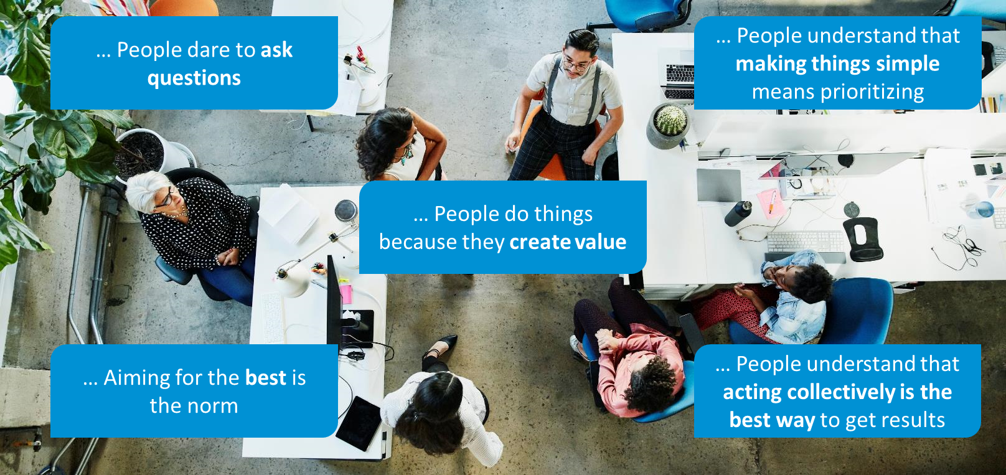
A place where…..

Slide 18
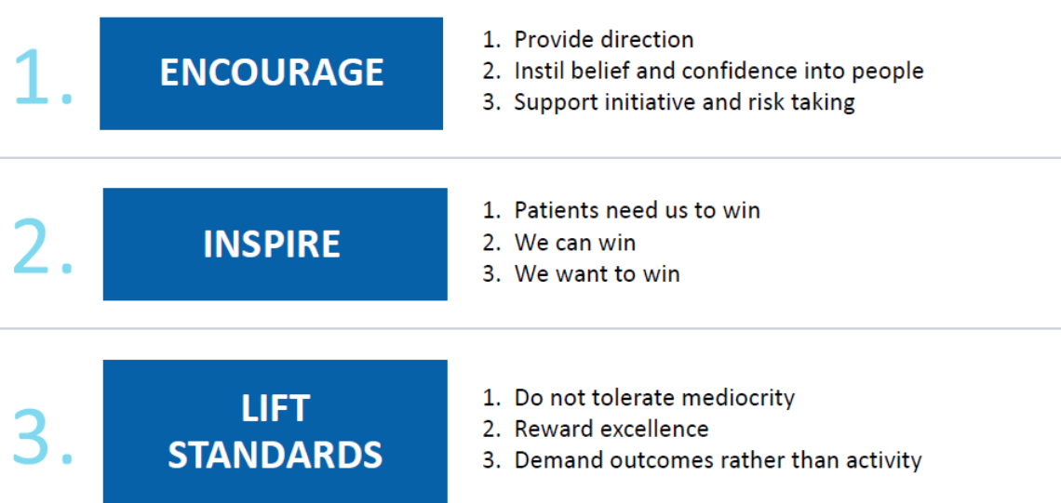
Our Play to Win approach as Leaders

Slide 19
Building a culture to support our future success

Slide 20


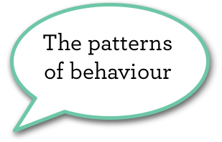

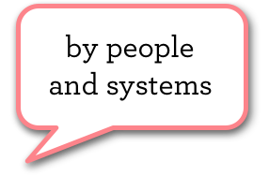
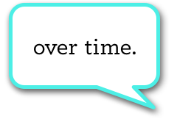

Slide 21



How is culture created?
Culture is created through the unspoken messages people
received about what is valued
How budgets are allocated
How time is spent
People, promotions, exit
Offices, car parks, titles…
Planning and budgeting
Performance review and reward
Measurement, reporting, learning
Structure….
What is role modeled
Meetings, conferences, emails
Interactions with others
….

Slide 22
Reflection Exercise: Symbols
What are the strongest symbols you see in Sanofi?
…………………………………………………………………………………………………………………….
…………………………………………………………………………………………………………………….
…………………………………………………………………………………………………………………….
What messages do they send about what is truly valued?
…………………………………………………………………………………………………………………….
…………………………………………………………………………………………………………………….
…………………………………………………………………………………………………………………….

Slide 23

Break Out Activity 30 Minutes
On the next slide you will see a total of 36 images. In your break-out groups, discuss and arrive at a consensus on the top 3 pictures that best represent the Culture@Sanofi India and tell us why?
Refer your participant workbook for the images
Identify a spokesperson who will represent the group in the plenary
Notes:
Debrief - Deliberate on what could be the barriers of cultural change, Examples of success / Examples of failures / Refer back to importance of Unspoke messages through 'Systems', Symbols' and 'Behaviours’
Decode the 4 winning behaviors
Know what makes people think we are doing well or badly wrt different behaviors
Enable reflection around the topic of culture change
Help participants that Cultur change / transformation is not ane event but a journey

Slide 24

Which 3 Images best represent the current culture at Sanofi?
Break Out Activity – 30 minutes

Slide 25
Which 3 Images best represent the current culture at Sanofi?
Break Out Activity – 30 minutes

Slide 26
Which 3 Images best represent the current culture at Sanofi?
Break Out Activity – 30 minutes

Slide 27
Which 3 Images best represent the current culture at Sanofi?
Break Out Activity – 30 minutes

Slide 28
Which 3 Images best represent the current culture at Sanofi?
Break Out Activity – 30 minutes

Slide 29
Break out activity – Summary of Group Discussion
You may use this slide to summarize your group’s output

Slide 30
Focusing on the « How » to shift our culture
#1. Stretch to go beyond the level we have operated
at up until now
#2. Act in the interest of our patients and customers
The four behaviours will gradually replace the LEAD competencies
#3. Take action instead of waiting
to be told
what to do
#4. Put the interests of the organisation ahead of my own
or those of our team
©Walking the Talk, Ltd, 2020 All rights reserved | WTT1

Slide 31
4 Play to Win observable behaviors
#1. Stretch to go beyond the level we have operated
at up until now
Constantly challenge the status quo to get a better outcome
Focus on the priorities that will deliver the best outcomes and stops activities that won’t
Don’t tolerate mediocrity
Ensure that stretching, challenging and doing things differently doesn’t compromise our values and sound judgement
#2. Take action instead of waiting to be told what to do
Take smart and informed bets based on the information at hand, even if that is not 100% complete
Make bold and impactful decisions which move us forward
In any situation focus on what we can constructively do, despite the constrains
Constantly ask how we can take action without waiting to be told what to do
#3. Act in the interest of our patients and customers
Actively engage with patients and customers to know their current and future needs
When making decisions, is that in the interest of our patients/customers?
#4. Put the interests of the organization ahead of my own
or those of our team
Consider both the long and short-term impact of decisions
Put collective and global goals above individual or local goals
Share resources and capabilities with those with the greatest need and/or potential impact
Enable decision making at the appropriate level
©Walking the Talk, Ltd, 2020 All rights reserved | WTT1

Slide 32
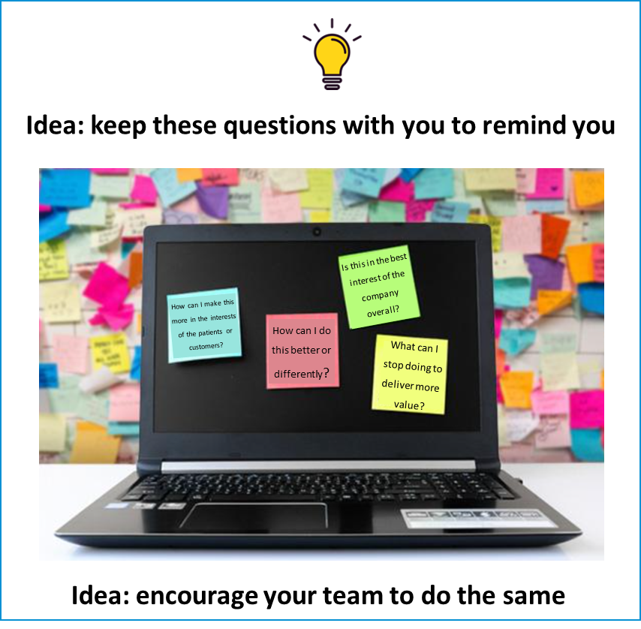
Leveraging the power of questions
Every day, everywhere, everyone should ask…
How can I make this more in the interests
of the patients or customers?
How can I do this better or differently?
What action can I take right now?
Is this in the best interest of the company overall?
What can I stop doing to deliver more value?
Notes:
Instructions
Each person share 1 experience over the past 3 months on which to apply the questions and share how different the outcome would have been

Slide 33
Day 1: Reflection

Slide 34
Personal Reflection for Day 2 Which of the 4 behaviours will be the easiest and which will be the most challenging for us to demonstrate?
Most challenging: …………………………………………………………………………………………………………………….
…………………………………………………………………………………………………………………….
…………………………………………………………………………………………………………………….
Idea: use this exercise with your team to get them thinking about culture change for themselves
Easiest: …………………………………………………………………………………………………………………….
…………………………………………………………………………………………………………………….
…………………………………………………………………………………………………………………….
©Walking the Talk, Ltd, 2020 All rights reserved | WTT1
©Walking the Talk, Ltd, 2020 All rights reserved | WTT1
©Walking the Talk, Ltd, 2020 All rights reserved | WTT1

Slide 35
Personal Reflection and Insights - Day 1
You may use this slide to summarize your key insights for the day

